Slide 1


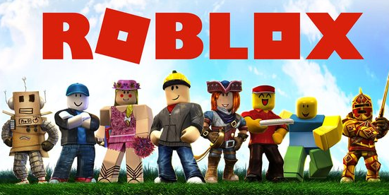
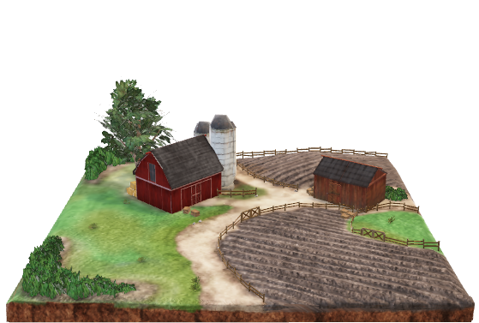
Functional architecture
Image Model
Mcc
IN-CSE
ADN-AE1
Mca
ADN-AE1
ADN-AE1
Cloud Service
Platform
ADN-AE1
MN-AE
Sensors
Mca
IN-AE
MN-CSE
ADN-AE2
ADN-AE1
ADN-AE1
Device with Metaverse application
ADN-AE1
Mca
Farm Gateway
Actuators

Slide 2
Application registration
AND-AE1
AND-AE2
MN-AE
MN-CSE
IN-CSE
IN-AE
Farm Gateway registration into Mobius
Image model application registration into Farm gateway
1
Sensor application registration into Farm gateway
2
3-1
Actuator application registration into Farm gateway
Roblox application registration into Mobius
3-2
4

Slide 3
Discovery and retrieval of sensor contentInstance resources
AND-AE1
AND-AE2
MN-AE
MN-CSE
IN-CSE
IN-AE
Discovery single sensor container with filter criteria
1-2
1-1
URIs of discovered container resources are responded
2-1
2-2
Retrieval of the latest contentInstance from discovered sensor[n] container
3-n-2
3-n-1
the latest contentInstance of sensor[n] container is responded
4-n-1
4-n-2

Slide 4
Single actuator control
AND-AE1
AND-AE2
MN-AE
MN-CSE
IN-CSE
IN-AE
Notification with the latest actuator state to be executed to the controlled actuator
1-2
1-1
Creation of an actuator contentInstance with new state
2-1

Slide 5

Use case
metaverse
real farm
Measure temperature, humidity …
Check plant
condition
Detect plant diseases
Take appropriate actions
User
Water the plant …

